Slide 1
Theme 3
Alex Burnham
23 August 2022

Slide 2
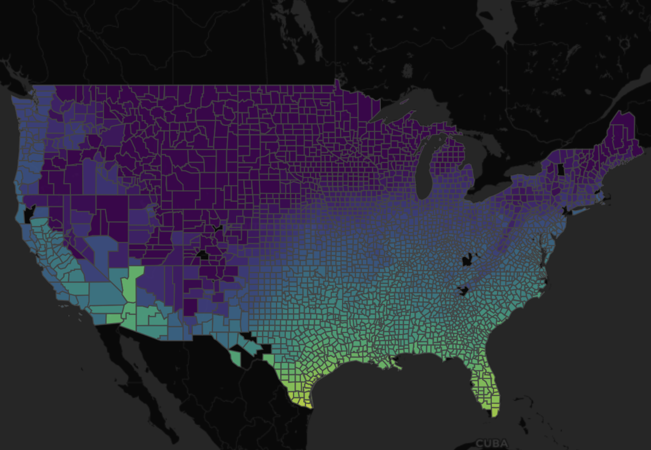
The goals of this theme…
Goal 1: To develop a high-level computational tool kit for cleaning and analyzing spatiotemporal data.
Goal 2: Design a dashboard or web application to visualize these data.

Slide 3
The goals of this theme…
Goal 1: To develop a high-level computational tool kit for cleaning and analyzing spatiotemporal data.
Goal 2: Design a dashboard or web application to visualize these data.

Slide 4
Background on Spatiotemporal Data

Slide 5
Background on Spatiotemporal Data
Latitude
Longitude

Slide 6
Background on Spatiotemporal Data
Latitude
Longitude

Slide 7
Background on Spatiotemporal Data
Latitude
Time
Longitude

Slide 8
Background on Spatiotemporal Data
Multiple time points for the same spatial area make analyzing and storing these data more complicated
Latitude
Time
Longitude

Slide 9
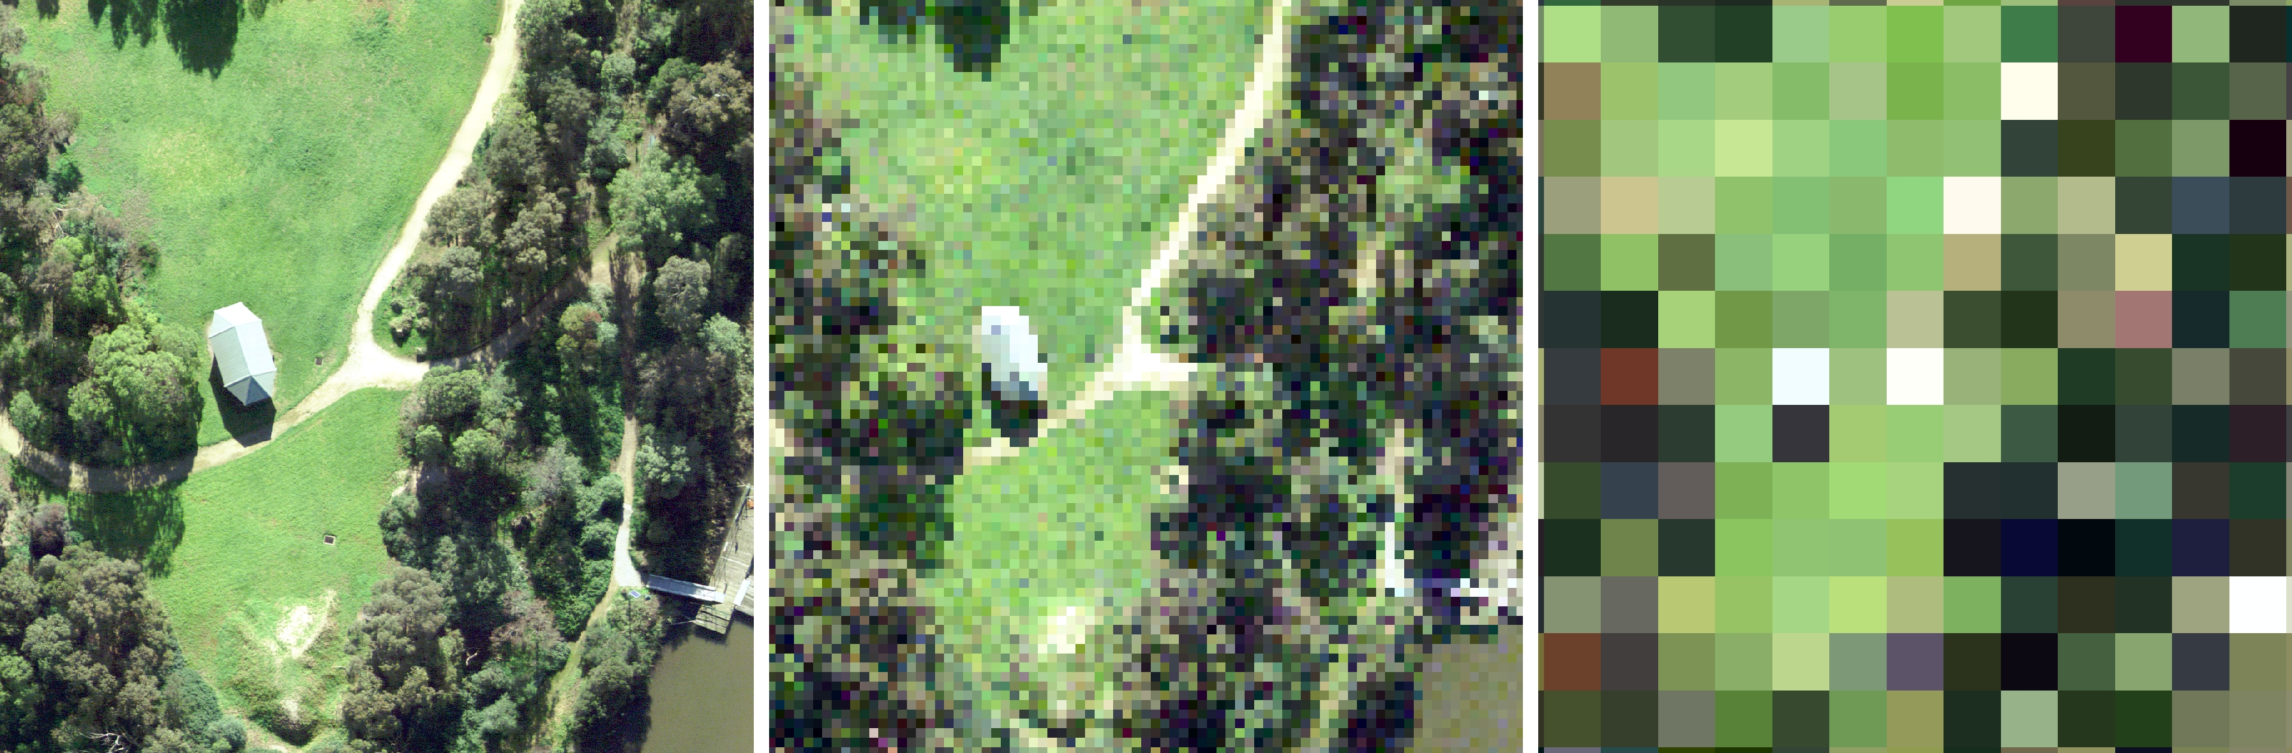
These data are often stored in raster files
Raster File: A file that stores an image as values for a given pixel in space.
Common File Types:
.tif
.nc4
.png
.jpeg

Slide 10
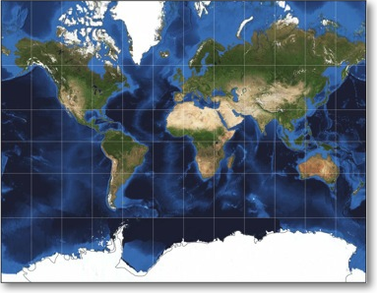
Spatial Data Dilemmas
Big data (storage, computational overhead etc.)

Slide 11
Spatial Data Dilemmas
Big data (storage, computational overhead etc.)
Dimensionality of various files types

Slide 12
Spatial Data Dilemmas (dimensionality)
McGill et al., 2020 (Grant Proposal)

Slide 13
Let’s talk about data cubes
Ideal for storing spatiotemporal data
Can be D-dimensional
Quick vectorized operations between cells
Time
Latitude
Longitude

Slide 14
Setting up an example cube
We have our index variables
Time
Latitude
Longitude

Slide 15
Setting up an example cube
We have our index variables
Latitude
Longitude
Time
Time
Latitude
Longitude

Slide 16
Setting up an example cube
We have our index variables
Latitude
Longitude
Time
Time
Latitude
Longitude

Slide 17
Setting up an example cube
We have our index variables
Latitude
Longitude
Time
And our variables of interest
Time
Temperature
Latitude
Longitude

Slide 18
Setting up an example cube
We have our index variables
Latitude
Longitude
Time
And our variables of interest
23ºC
Time
Temperature
Latitude
Longitude

Slide 19
Setting up an example cube
We have our index variables
Latitude
Longitude
Time
Higher dimensions
Time
Temperature
Humidity
Precipitation
Latitude
Longitude

Slide 20
Setting up an example cube
We have our index variables
Latitude
Longitude
Time
Higher dimensions
Time
Temperature
Humidity
Precipitation
Latitude
Longitude

Slide 21
Setting up an example cube
We have our index variables
Latitude
Longitude
Time
Higher dimensions
Time
Temperature
Humidity
Precipitation
(24, 57, 256)
Latitude
Longitude

Slide 22
Setting up an example cube
We have our index variables
Latitude
Longitude
Time
Higher dimensions
Time
Temperature
Humidity
Precipitation
(24, 57, 256)
Latitude
Longitude

Slide 23
Spatial Data Dilemmas
Big data (storage, computational overhead etc.)
Dimensionality of various files types
Tons of different spatial references systems

Slide 24
Spatial Data Dilemmas
Big data (storage, computational overhead etc.)
Dimensionality of various files types
Tons of different spatial references systems
Temporal and spatial alignment

Slide 25
Spatial Data Dilemmas
Big data (storage, computational overhead etc.)
Dimensionality of various files types
Tons of different spatial references systems
Temporal and spatial alignment
Tools to solve these issues are not at the hands of the average user

Slide 26
Spatial Data Dilemmas
Big data (storage, computational overhead etc.)
Dimensionality of various files types
Tons of different spatial references systems
Temporal and spatial alignment
Tools to solve these issues are not at the hands of the average user

Slide 27


Slide 28
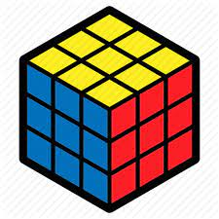
A simple example with 3 Rasters
Latitude
Time
Longitude

Slide 29
A simple example with 3 Rasters
Latitude
Latitude
Time
Time
Longitude
Longitude

Slide 30
A simple example with 3 Rasters
Latitude
Latitude
Time
Time
Latitude
Time
Longitude
Longitude
Longitude

Slide 31
A 3D Spatiotemporal Cube
Latitude
Time
Longitude

Slide 32
So you could do things like…
z
Time
X
y
Latitude
Longitude
Time
Time
Longitude
Longitude

Slide 33
Or…
X
y
mean
,
Latitude
Time
Time
Longitude
Longitude

Slide 34
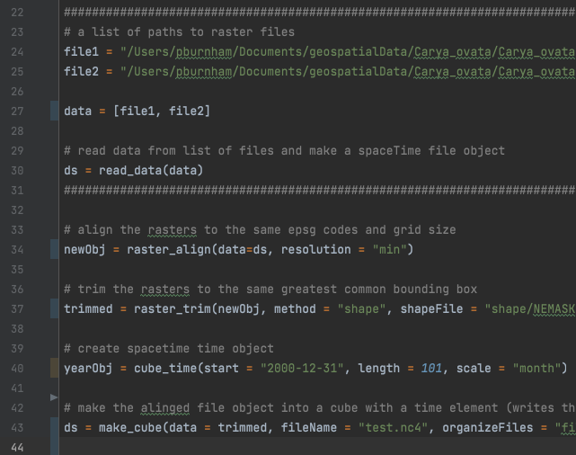

Structure and Syntax

Slide 35
The Workflow…
Unprocessed Raster Files
Spacetime File Object
raster_align()
Cleaned File Object
read_data()
raster_trim()
make_cube()
Spacetime Cube Object
(new file written to disk)
scale_time()
Modified Cube Object
New Cube Object
(new file written to disk)
…
make_cube()
etc()

Slide 36
Pre-Cube Operations
Unprocessed Raster Files
Spacetime File Object
raster_align()
Cleaned File Object
read_data()
raster_trim()
make_cube()
Spacetime Cube Object
(new file written to disk)
scale_time()
Modified Cube Object
New Cube Object
(new file written to disk)
…
make_cube()
etc()

Slide 37
Post-Cube Operations
Unprocessed Raster Files
Spacetime File Object
raster_align()
Cleaned File Object
read_data()
raster_trim()
make_cube()
Spacetime Cube Object
(new file written to disk)
scale_time()
Modified Cube Object
New Cube Object
(new file written to disk)
…
make_cube()
etc()

Slide 38
Where files are cleaned
Unprocessed Raster Files
Spacetime File Object
raster_align()
Cleaned File Object
read_data()
raster_trim()
make_cube()
Spacetime Cube Object
(new file written to disk)
scale_time()
Modified Cube Object
New Cube Object
(new file written to disk)
…
make_cube()
etc()

Slide 39
Operations on cubes
Unprocessed Raster Files
Spacetime File Object
raster_align()
Cleaned File Object
read_data()
raster_trim()
make_cube()
Spacetime Cube Object
(new file written to disk)
scale_time()
Modified Cube Object
New Cube Object
(new file written to disk)
…
make_cube()
etc()

Slide 40
Read the cube in at any time…
Spacetime Cube File
Spacetime Object
scale_time()
Modified Cube Object
load_cube()
…
etc()
New Cube Object
(new file written to disk)
make_cube()
Rinse and Repeat

Slide 41

Python Syntax
Spacetime is written in python
Anatomy of a python function:
object = function(data = ds, method = ”mean", num = 10)
Object name
Function name
Arguments

Slide 42
Python Syntax
Spacetime is written in python
Anatomy of a python function:
object = function(data = ds, method = ”mean", num = 10)
Pass a dataset
Pass a setting to the function
Or a numeric value

Slide 43
Python Syntax
Spacetime is written in python
Anatomy of a python function:
object = function(data = ds, method = ”mean", num = 10)
Python objects have methods:
print(object.python_method(method = ”mean", num = 10)
Object name
Method name
Methods can take arguments

Slide 44
Python Syntax
Spacetime is written in python
Anatomy of a python function:
object = function(data = ds, method = ”mean", num = 10)
Python objects have methods:
print(object.python_method(method = ”mean", num = 10)
This result could be stored as a new object
Pri. newObj = object.python_method(method = ”mean”))

Slide 45
Python Syntax
Spacetime is written in python
Anatomy of a python function:
object = function(data = ds, method = ”mean", num = 10)
Python objects have methods:
print(object.python_method(method = ”mean", num = 10)
Or printed directly to the console
Pri. print(object.python_method(method = ”mean”))

Slide 46
Current Capabilities
Read in common raster data types
Rescale files to a common SRS and grid size
Trim datasets to the same bounding box/shape
Select and rescale data along the time dimension
Mathematical and function-based cube operations
Return cube using a tabular format (dataframe)
Plot cube spatially or temporally

Slide 47
The Spacetime API
An example spacetime function:

Slide 48
The Spacetime API
Spacetime cube object methods:

Slide 49
Example Spacetime script

Slide 50
Example Spacetime script
data = [“file1.tif”, “file2.tif”, “file3.tif”] # read in raster files

Slide 51
Example Spacetime script
data = [“file1.tif”, “file2.tif”, “file3.tif”] # read in raster files ds = read_data(data) # read data in as a file object

Slide 52
Example Spacetime script
data = [“file1.tif”, “file2.tif”, “file3.tif”] # read in raster files ds = read_data(data) # read data in as a file object newObj = raster_align(data=ds, resolution = "min", algorithm="sum") # Align the files

Slide 53
Example Spacetime script
data = [“file1.tif”, “file2.tif”, “file3.tif”] # read in raster files ds = read_data(data) # read data in as a file object newObj = raster_align(data=ds, resolution = "min", algorithm="sum") # Align the files trimmed = raster_trim(newObj, method = "intersection") # Trim the files

Slide 54
Example Spacetime script
data = [“file1.tif”, “file2.tif”, “file3.tif”] # read in raster files ds = read_data(data) # read data in as a file object newObj = raster_align(data=ds, resolution = "min", algorithm="sum") # Align the files trimmed = raster_trim(newObj, method = "intersection") # Trim the files
# Make the cube and output a .nc4 file to disk cube = make_cube(data = trimmed, fileName = "test.nc4", organizeFiles = "filestovar", organizeBands = "bandstotime)

Slide 55
Jumping into some code

Slide 56
NetCDF4 and GeoTIFF
Used specifically for storing spatial data
Contain metadata for mapping data points to a spatial location

